Slide 1

Personality classifier
Know yourself.

Slide 2
TABLE OF CONTENTS
01
02
04
INTRODUCTION
GOAL
03
DEMO
TECHNOLOGY
05
Contact us

Slide 3
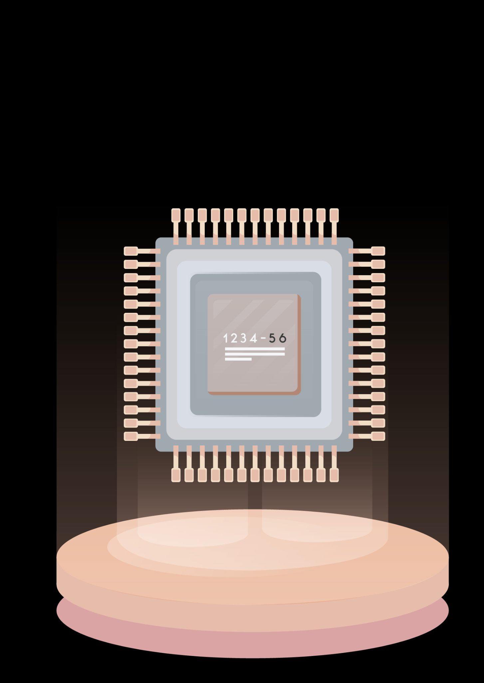
01
INTRODUCTION

Slide 4

INTRODUCTION
In the age of personalization, understanding one’s personality can offer invaluable insights into personal development and relationship building.
Our personality classifier aims to provide users with an engaging and interactive experience that combines self-reflection with technology.
By allowing users to submit a self-description alongside their image, the classifier predicts their Myers-Briggs Type Indicator (MBTI) personality type (e.g., INFP, ESTJ) based on the input text.

Slide 5
But what is MBTI?
The Myers-Briggs Type Indicator (MBTI) is a psychological tool used to assess and categorize an individual's personality based on their preferences in four dichotomies.
Each person is classified into one of 16 personality types, represented by a four-letter code (e.g., INFP, ESTJ)

Slide 6
Introversion (I) vs. Extraversion (E):
Introversion (انطوائية): Prefers solitude and feels energized by spending time alone.
Extraversion (انبساطية): Feels energized by social interactions and being around others.
Sensing (S) vs. Intuition (N):
Sensing (دقيق): Focuses on concrete, practical information and details.
Intuition (جامع): Looks for patterns, possibilities, and big-picture ideas beyond the immediate details.
Thinking (T) vs. Feeling (F):
Thinking (عقل): Makes decisions based on logic and objective facts.
Feeling (قلب): Makes decisions based on personal values and the feelings of others.
Judging (J) vs. Perceiving (P):
Judging (حكم): Prefers structure, organization, and making decisions quickly.
Perceiving (تقبل): Is more flexible, open to new information, and prefers to keep options open.
What is MBTI classes?

Slide 7
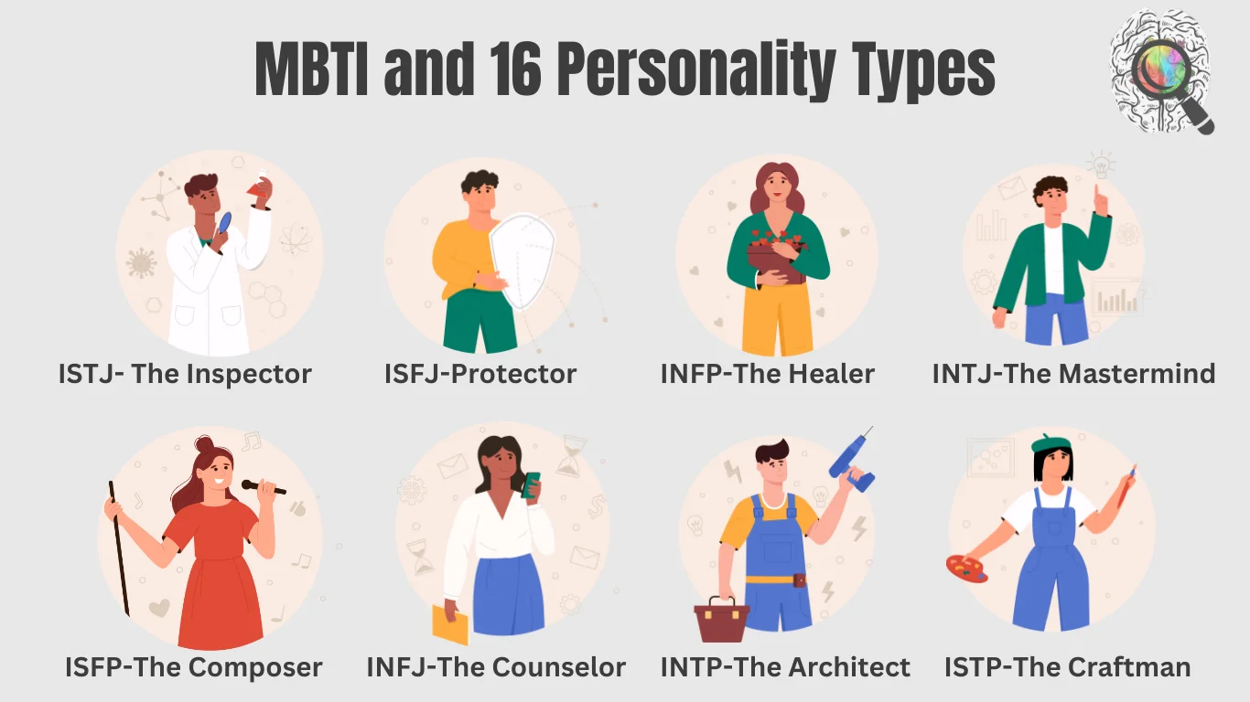

Slide 8

02
GOAL

Slide 9
The primary goal of this project is to develop a robust personality classification tool that leverages user input in the form of written descriptions and images.
GOAL
Users will be able to register, log in, and provide a narrative about themselves, which the model will analyse to generate an accurate prediction of their MBTI personality type.
By harnessing the power of machine learning and natural language processing, we aim to create a user-friendly application that enhances personal understanding and encourages meaningful self-exploration.

Slide 10
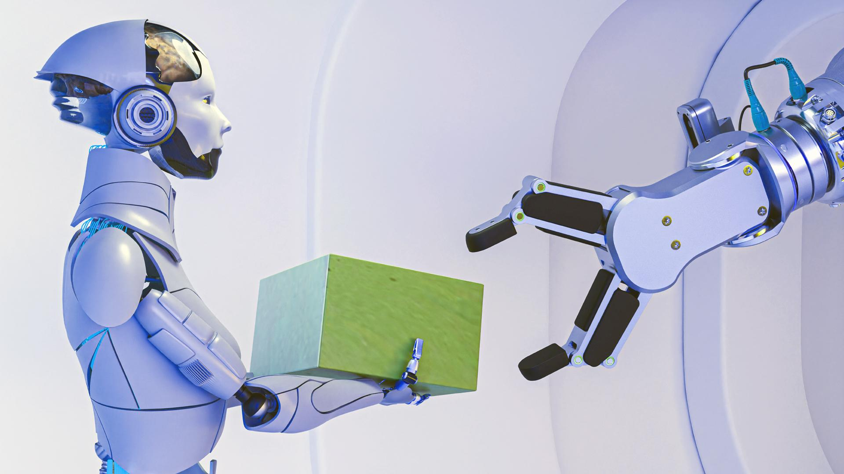
03 DEMO

Slide 11
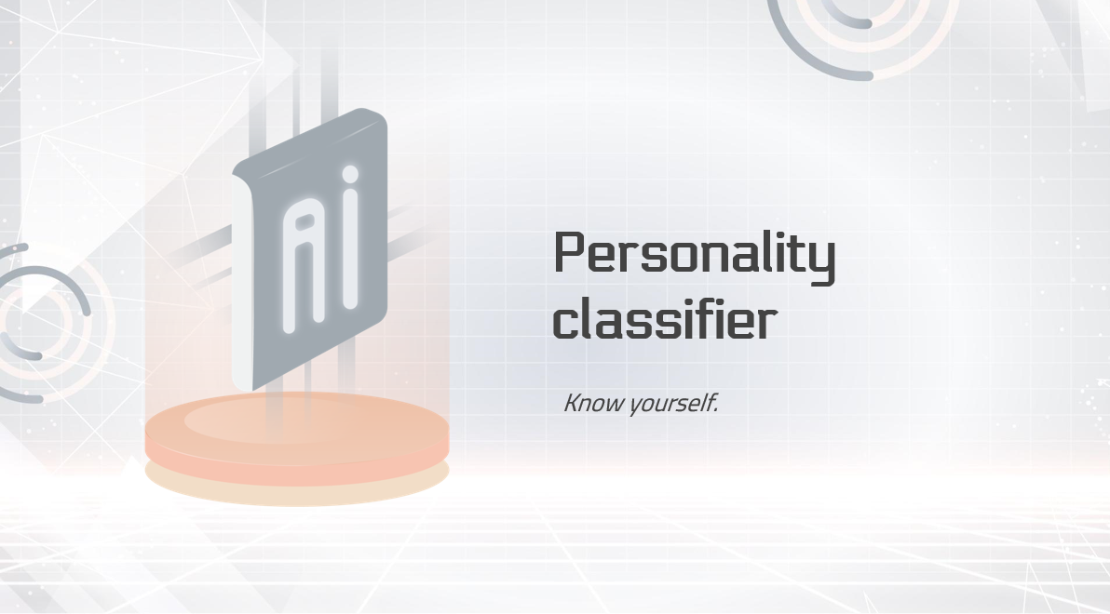
05 Technology

Slide 12
Technology
Data Processing and Analysis:
Pandas: Used for reading and processing the dataset containing MBTI posts.
NumPy: Aids in numerical operations and data manipulation.
NLTK: Utilized for natural language processing tasks, including stopword removal.
spaCy: Implements advanced text processing techniques, such as lemmatization, to refine the input data.

Slide 13
Technology
Feature Extraction:
TfidfVectorizer: Converts text data into a numerical format that can be used by machine learning models, capturing the importance of words relative to the entire dataset.
Modeling:
Logistic Regression and LinearSVC: These machine learning algorithms classify personality types based on the extracted features from the input text. Both models are trained on a subset of the data to learn patterns associated with each MBTI type.
Pipeline: A scikit-learn feature that streamlines the modeling process by encapsulating the steps of feature extraction and classification into a single object.

Slide 14
Technology
Evaluation:
Confusion Matrix: Visualizes the performance of the classification model, allowing us to assess the accuracy and identify any misclassifications.
Classification Report: Provides detailed metrics on model performance, including precision, recall, and F1-score.
User Interface:
Tkinter: The GUI framework for building the application
OpenCV: Handles image capture and processing for user registration, allowing users to upload their images seamlessly.
Visualization:
Plotly and Matplotlib: Used for visualizing word frequency distributions and the confusion matrix to gain insights into the model's performance and the dataset characteristics.

Slide 15

THANKS!
Authors:
Ehab Nasr
Ibrahim Mustafa
Osama Keshta
Special thanks to our teachers
Eng.Asma
Eng.Enas
Eng.Amr
PROJECT ON GITHUB

Slide 16
Source for PowerPoint slidesgo

